Slide 1
B1.3 Intermediate book third edition

Slide 2
JESICA VANESSA SARMIENTO MUÑOZ Licenciada en Inglés Universidad Industrial de Santander
www.jesvasar.weebly.com
BLOG

Slide 3
To take into account:
Attendance and punctuality (15 minutes)
Cellphones use.
Dictionaries:
Responsability

Slide 4
Exams:
Mid Term Exam (30%): May 30th
Final Exam (50%): July 4th
Classwork (35%): Quizzes,
Project: NO
Moodle (5%)

Slide 5
Re-take and make-up exams: July 9th and 10th
Next level begins: July 18th

Slide 6
MY ENGLISH LAB (5
Not activated yet.

Slide 7
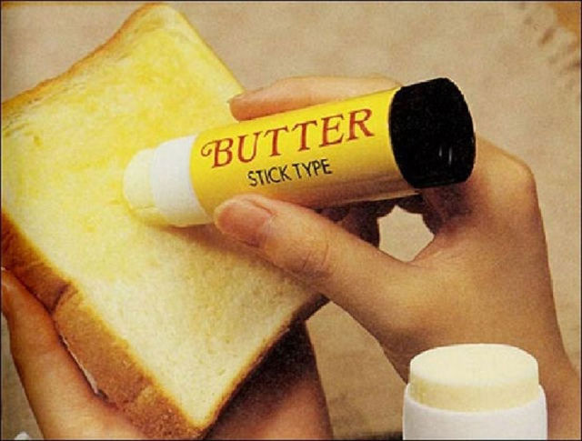

Slide 9
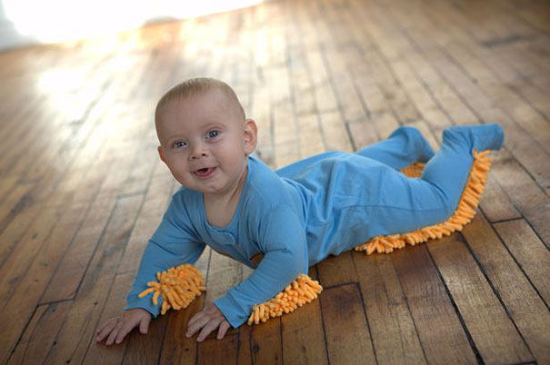

Slide 11
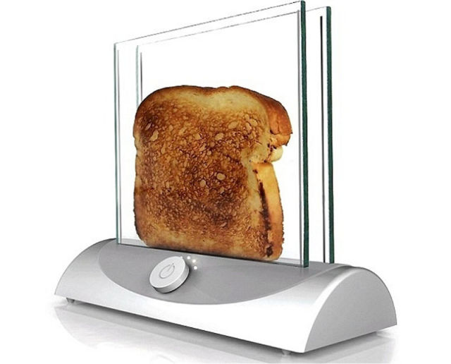

Slide 12
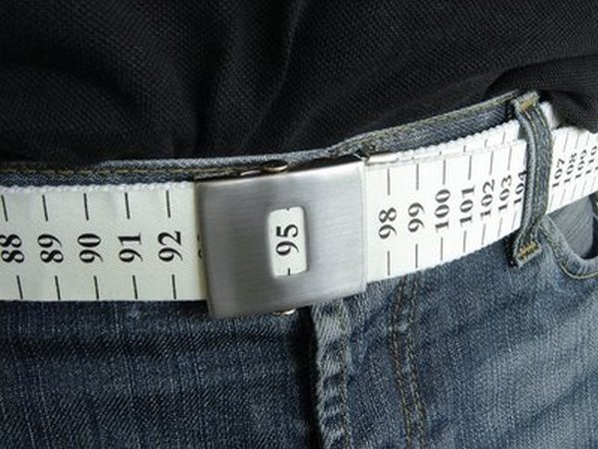

Slide 13
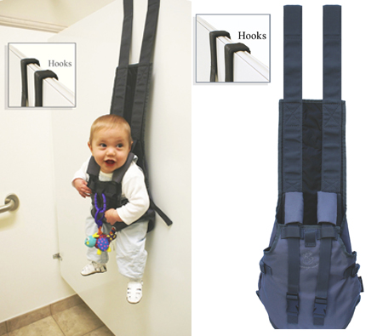

Slide 16
